Slide 1

Employee Attrition Analysis
Samir Atpadkar

Slide 2
Agenda
Introduction​
Significance
KPI
Dashboard
Insight ​And Analysis

Slide 3
Introduction
The Human Resources (HR) Director has observed a concerning trend of employees leaving the company and is committed to identifying the underlying factors contributing to this attrition.
Identify Trends and Patterns: The primary objective of this project is to analyze the attrition rate within Green Destination over a specific period.
Determine Key Factors: We will investigate the factors affecting attrition within the company. This includes but is not limited to factors such as age, years of service, income, job roles, and any other relevant variables.
Recommendation for Retention: Based on our analysis, we will provide recommendations for employee retention strategies.

Slide 4
Significance
The significance of this project lies in its potential to provide Green Destination with actionable insights. By understanding the reasons behind employee attrition, the company can make informed decisions to enhance employee satisfaction, loyalty, and overall performance. This project aligns with the company's goal of retaining valuable talent and maintaining its position as a top travel agency.

Slide 5
Main KPIs:
Count of Employee
Attrition count
Attrition Rate
Average Age
Average Salary
Average years at company

Slide 6
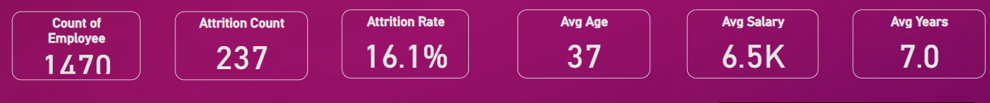
KPI’s IN Dashboard

Slide 7
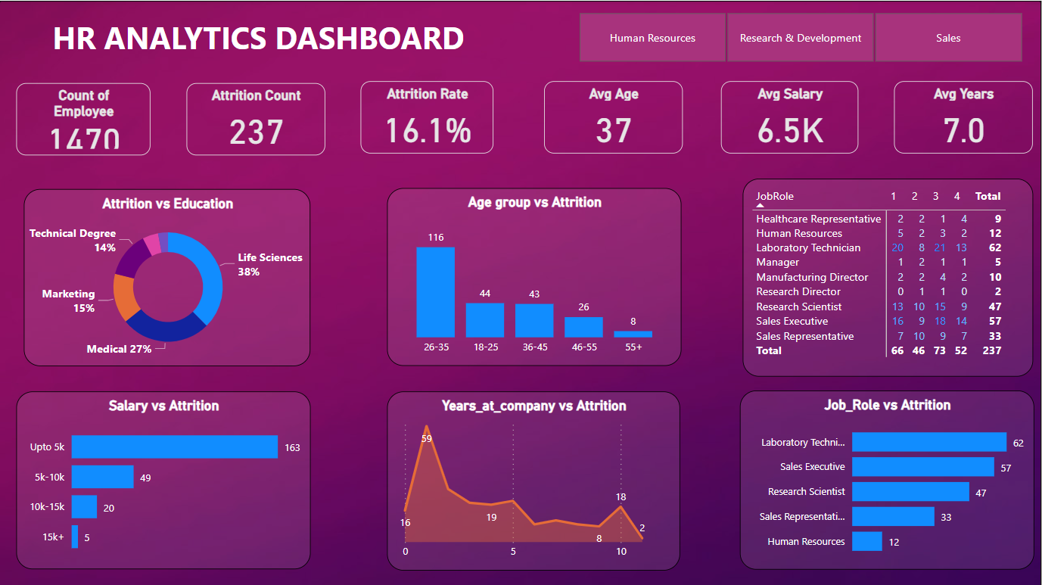
Dashboard Overview

Slide 8
Insight and analysis
Age Group : The age group between 25 to 35 exhibits a higher attrition rate at Green Destination, indicating the need for targeted retention strategies and a deeper understanding of their specific concerns.
Education Impact : In the fields of life science and medical education, employee attrition rates are higher compared to other industries. Understanding and addressing these trends is crucial for talent retention.
Years at company : A significant number of employees tend to leave the company after completing their first year, indicating a potential need for improved onboarding, engagement, and retention strategies.
Salary : Employees with salaries below 5K have a higher attrition rate, highlighting the impact of compensation on retention. Addressing salary disparities may be essential to reduce attrition.

Slide 9
Conclusion
In Green Destination, the age group of 25 to 35 experiences higher attrition rates. Targeted retention strategies for this group are essential. Additionally, many employees depart after their first year, suggesting a need for improved onboarding and engagement. Low salaries below 5k rs are associated with higher attrition, emphasizing the importance of fair compensation.

Slide 10
THANK YOU
Samir Atpadkar
samatpadkar183@gmail.com

